Slide 1
Introduction to Unix
Overview and first session
Based on lecture notes from the following:
Phil Pfeiffer, Ron Zucker, & Jack Ramsey – ETSU
Hussam Abu-Libdeh – Cornell University
Eric Eaton – University of Pennsylvania

Slide 2
Topics
Course Info
Course Goals
Assumptions
What is Unix?
A Brief History of Unix
Flavors of Unix
Unix OS Overview
Introduction to Unix Commands

Slide 3
Course Information█
Office Location:
Currently Nicks 484
Office Hours:
MW 12:00 - 2:30
TR 8:00 - 9:00 / 11:05 - 12:05
Email: ramseyjw@etsu.edu
Best way to reach me

Slide 4
Course Goals█
Overall Mission
Gain knowledge of Unix and Unix-like command line environments.
Master basic Unix commands.
Gain experience with Unix-based shell scripting.

Slide 5
Course Goals█
Basics
How Unix compares to Windows and DOS
Logging in, navigating the OS file structure
Commands
Systems operations:
Create/remove files and directories
Set permissions

Slide 6
Course Goals█
Using a CLI text editor
Nano, vi, vim
Advanced commands
Pipes and filters
Multiprocessing
jobs, ps, kill

Slide 7
Course Goals█
Finding information
find, grep, locate
Regular expressions -> pattern matching
Bash Shell Scripting
Brief Introduction to Systems Administration

Slide 8
Assumptions█
You’ve never used a command line interface before
You know at least one programming language that uses if/else logic and loops

Slide 9
Ready?

Slide 10
What is Unix?█
It’s an Operating System (OS)
So?

Slide 11

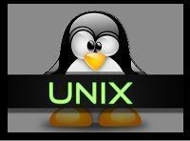
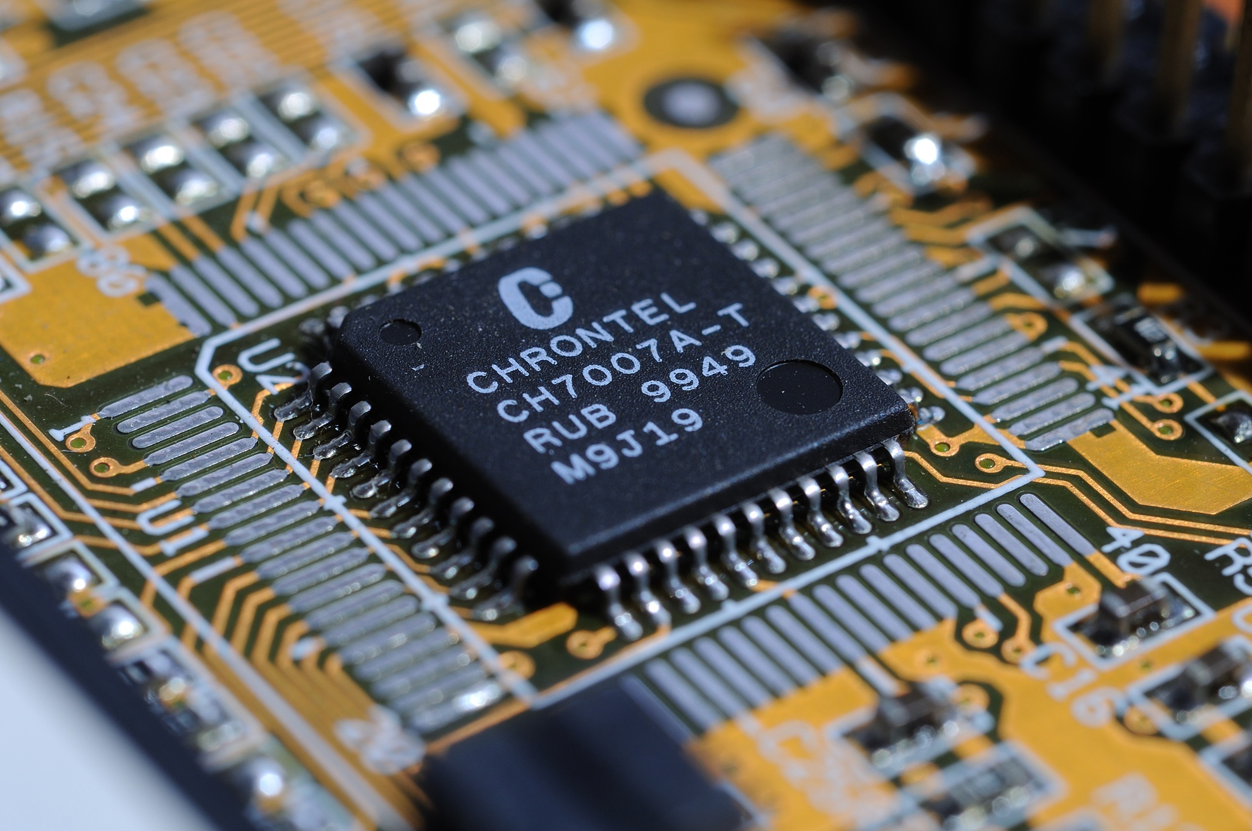
What is Unix?█
What’s an Operating System?
It’s a resource manager
Provides a user interface
Allows sharing of hardware
Provides a means for sharing data
May schedule resource usage among multiple users

Slide 12
What is Unix?█
What’s an Operating System?
May schedule resource usage among multiple tasks
Facilitates input and output
Provides graceful error recovery
An OS runs underneath… you interact with it but are unaware of the majority of what it does

Slide 13
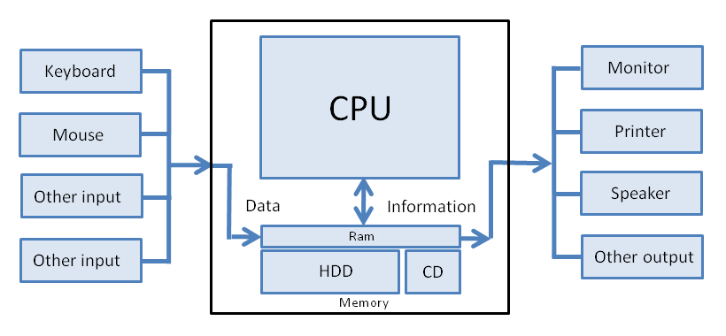
What is Unix?█
Source: http://en.wikiversity.org/wiki/Computer_hardware_and_software

Slide 14
What is Unix?█
More generally:
One of the first widely-used operating systems
Many OS are based on Unix
Linux
OSX
Android

Slide 15
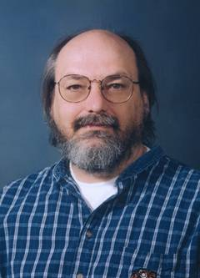
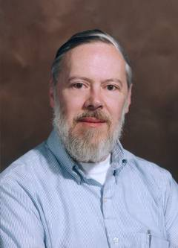
A Brief History of Unix █
1964
MIT, GE and Bell Labs (AT&T) start the Multics (Multiplexed Information and Computing Service) project
Frustration over mission creep causes Ma Bell to leave the project
1969
Bell Labs employees Ken Thompson and Dennis Ritchie take the good parts of Multics (pipes and shells) and create a scaled down version called UNICS

Slide 16
A Brief History of Unix █
What’s in a name?
Unix may be shown as UNIX ®, Unix, Unix®
UNIX® is a registered trademark of The Open Group (as of 2007) the certifying body of the UNIX trademark
Two theories on the name:
The U in UNIX meant uniplexed as opposed to Multics multiplexed
It is a pun as Unix sounds the same as Eunuchs

Slide 17
A Brief History of Unix █
1973
Unix was originally written in Assembly. In ’73, it was almost entirely rewritten in C, a much easier programming language, leading to wider adoption of the OS
Due to the settlement of an antitrust case in the late 1950s, AT&T could not enter the computer market. Therefore, they could not sell Unix, and they were required to give non-telephone technology to anyone that requested it.

Slide 18
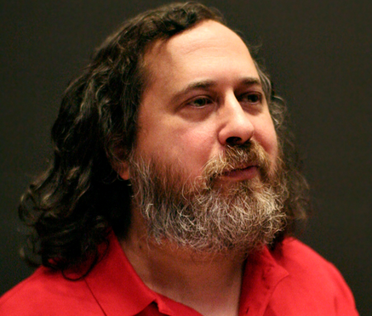
A Brief History of Unix █
1977
Berkley Software Distro (BSD) is first released.
1982
Sun Microsystems releases SunOS
1984
HP-UX (Hewlett-Packard Unix) is released
Richard Stallman quits job at MIT to work on the GNU project

Slide 19
A Brief History of Unix █
What’s GNU?
GNU is Not Unix (GNU)
As Unix took off in popularity, companies started restricting access to their code. Stallman disliked this stifling of programming freedom
The intent of GNU was to license software so that it would be free and open source

Slide 20

A Brief History of Unix █
1987
Andrew Tanenbaum releases the first Unix-like OS, MINIX, for educational purposes
1991
Linux is first released. Created by Linus Torvalds. MINIX could only be licensed for educational use, so Linus built his own kernel. He used GNU tools and released the OS under the GNU General Public License (GPL)

Slide 21
A Brief History of Unix █
Linux is not Unix!
It is Unix-like since it is not fully compliant with the Single Unix Specification (SUS)
Linux does adhere to the Portable OS Interface (POSIX) standard which means the user interface is indistinguishable from the UNIX interface
We will actually be doing all our work on a Linux (Ubuntu) server

Slide 22
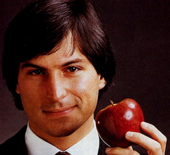
A Brief History of Unix █
1997
Apple uses NEXTSTEP, developed by NeXT (also a Steve Jobs created company)
This would be the precursor to Mac OS X

Slide 23
Flavors of Unix █
Apollo - DOMAIN/IX
Apple - A/UX (Apple/ Unix)
Berkeley - BSD
DEC - ULTRIX
HP - HP-UX
IBM - AIX
Santa Cruz Operations (SCO) - Xenix (initially Microsoft’s)
Sun – SunOS renamed Solaris
Zilog – Zeus
https://en.wikipedia.org/wiki/History_of_Unix

Slide 24
Flavors of Linux █
Ubuntu
Red Hat Enterprise Linux
Debian
CentOS
Suse
Lubuntu
Edubuntu
Slackware
Manjaro
EndeavourOS
Mint
Pop!_OS
+ ~250 more
https://distrowatch.com/

Slide 25
Unix OS Overview █
Control program for computers managing:
Processes
Multi users
Memory
Files

Slide 26
Unix OS Overview █
Provides support utilities called commands for:
Executing programs
File management
File editing
Process management

Slide 27
Unix OS Overview █
Runs on virtually every manufacturer's hardware
Works the same way on every computer
Components
Kernel
File system
Shell
Utilities

Slide 28
Unix OS Overview █
Shell
Kernel
H/W
interfaces
interfaces
interfaces
User
Unix

Slide 29

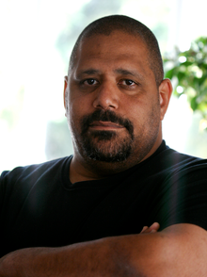
Unix OS Overview
Common Shells
Bourne Shell (sh)
Written by Stephen Bourne while at Bell Labs
Bourne Again Shell (bash)
Written by Brian Fox
Notes:
29

Slide 30
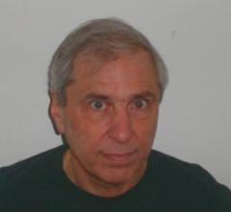
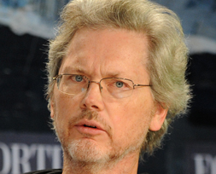
Unix OS Overview
Common Shells
Korn Shell (ksh)
David Korn Bell Labs
C Shell (csh)
Bill Joy as a grad student at UC Berkeley
We will be using bash
Notes:
30

Slide 31
Intro to Unix Commands
Syntax
Commands are case sensitive (e.g. date is not the same as Date)
All Unix commands are lowercase
Filenames and or directories may be upper or lowercase
IMO – use all lowercase + dashes, underscores
E.g., myfirstfile, my_first_file, my-first-file
Decide a standard way of doing things and stick with it

Slide 32

Intro to Unix Commands
Basic syntax for a Unix command:
command [options] [operands]
Where
command - the name of a Unix command
options – character[s] which are immediately preceded by either a minus (-) or plus (+) sign and may be upper or lowercase letters or digits (I still call them ‘switches,’ so I may slip)
operands – one or more values indicating filenames, directories, values, etc.

Slide 33
Intro to Unix Commands
Spaces are used as delimiters for Unix commands
ls-al won’t work: ls –al ✓
There must be at least one space between the: command, options, and operands

Slide 34
Intro to Unix Commands
ETSU Unix Environment
The Unix (Linux) host machine is username@csci2200.net
Your username is your ETSU username.
Your password is the last four digits of your “E” number
e.g. If your “E” number is E0002468, your password will initially be 2468
The port number is 22

Slide 35
Intro to Unix Commands
We’ll look at virtualization – VMware (either Workstation Player (free) or Workstation Pro (free with a university account))
You can spool up your own machine(s)
You’ll have full control, including the ability to frag your own machine
No danger, though, since a virtual machine is isolated from its host

Slide 36
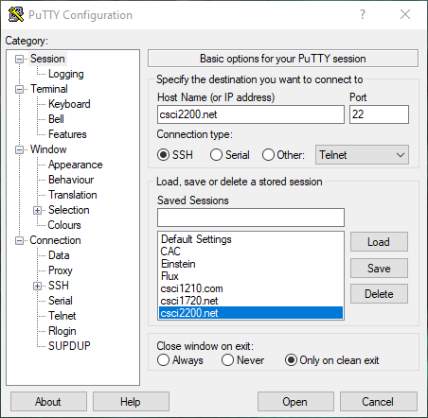
Intro to Unix Commands
Logging on
Download Putty (ninite.com)
PuTTY is a terminal emulator for Windows
Windows CLI can also be used, but PuTTY is a little better, IMO

Slide 37
Intro to Unix Commands

Slide 38
Intro to Unix Commands
Logging on
Type in your userid when prompted, then hit the return key
Type in the password followed by the return key
As a security feature, what you type in will not show up on the screen
Changing Passwords (passwd)

Slide 39
Intro to Unix Commands
Logging on
From the CLI
Enter ssh username@host
Enter password

Slide 40
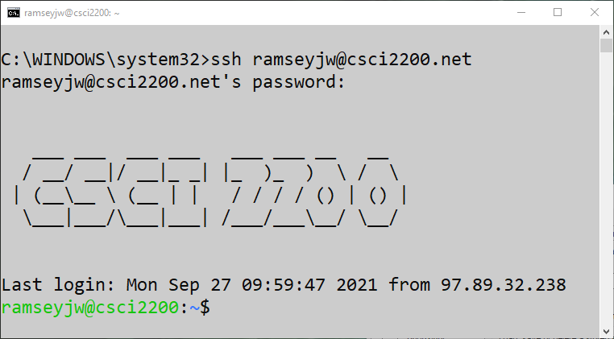
Intro to Unix Commands

Slide 41
Intro to Unix Commands
Some fun:
cal [mon] [year] # if the month is not provided, year is assumed
Provides a calendar to look at

Slide 42
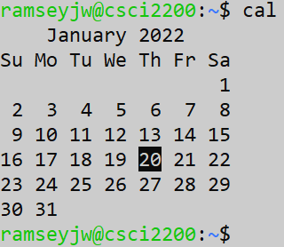
Intro to Unix Commands

Slide 43
Intro to Unix Commands
Getting help:
man [Unixcommand]
Hit return to advance a line at a time, use spacebar for advancing a page at a time, enter lowercase q to quit
Logging off (exit)

Slide 44
Intro to Unix Commands
Logging on
Once logged in, you will see the shell prompt
ramseyjw@ramseyjw:~$
Change your password when you first login
Enter passwd
Enter new password
Confirm password

Slide 45
Intro to Unix Commands
Password should be:
At least six characters in length
Two alpha, one non-alpha
Should not be login name, reverse of login name or login name shifted by one or more characters
The server is configured so it will not let you use or include dictionary words
I often use Leet-Speak, 1337.me

Slide 46
Intro to Unix Commands
Getting Help
man – provides a full description of the command
whatis – A short description of the command (same as typing man -f command)
apropos – searches for specified keyword in short description
Google

Slide 47
Intro to Unix Commands
Logging out
exit Bourne/Korn shells
^d (^ is the control key)
logout C shell
REMEMBER THIS!

Slide 48
Intro to Unix Commands
We will practice with many common commands throughout the semester
You may be wondering about the - sometimes cryptic - command names, i.e., ls (instead of list), man (instead of manual), cp (instead of copy), etc.
Dates back to the early days of computing, when memory was very expensive
Usually, I think the command name as I’m typing it in

Slide 49


